Slide 1
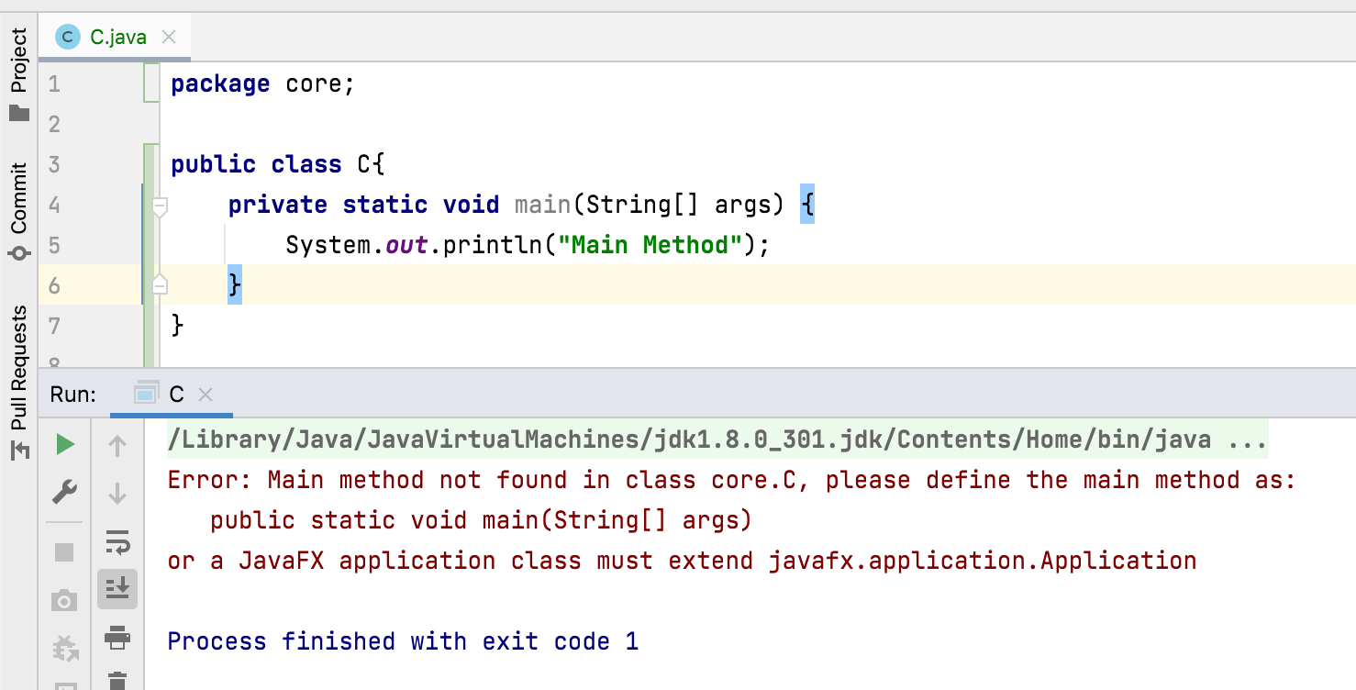
Can we declare main() method as private?
No, main() method must be public.
we can’t define main() method as private or protected or with no access modifier.
Because to make the main() method accessible to JVM.

